Slide 1
DISCRETE MATHEMATICS PROJECT
By:
Hannan Mushtaq (2023-CS-85)
M Ahmad (2023-CS-69)
To:
SIR WAQAS ALI

Slide 2
CONTENTS
Graph Theory
Number Theory

Slide 3
GRAPH THEORY (QUESTION 1)
Q. Analysis of Games Using Graph Theory
Investigate how certain games can be represented and analyzed using graph theory (at least two games).
Is Tic-Tac-Toe an example of a game that can be represented with graphs? Describe the graph and what you are trying to achieve or avoid. Consider studying Tic-Tac-Toe generalizations.

Slide 4
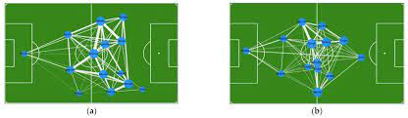
PART A (GAME 1)
Game 1: Football We can model and analyze various aspects of football, including player interactions, passing networks, and team dynamics. Here's a simplified explanation of how football can be conceptualized using graph theory.

Slide 5
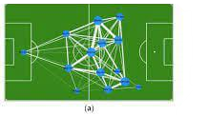
VERTICES IN FOOTBALL
Players: Each player on the field is represented as a vertex in the graph. The vertices are blue circles in the ground.
Ball: The ball itself is a vertex in the graph, representing its position on the field.
Goal Posts: Each goal post is a vertex in the graph.

Slide 6
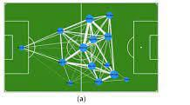
EDGES IN FOOTBALL
Player Connections: Edges between players represent interactions, such as passes or movements between them. If player A passes to player B, there is an edge between vertices A and B.
Ball Movements: Edges represent the movement of the ball. For example, if a player kicks the ball, there is an edge connecting the player's vertex to the ball's vertex.
Goal Attempts: Edges can be used to represent attempts to score goals. For instance, if a player shoots towards the goal, there's an edge connecting the player to the goal.
Dynamic Graphs: The football field is dynamic, and the graph representation changes rapidly during the game as players move, pass, and interact

Slide 7
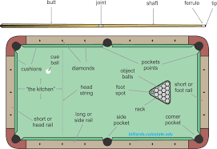
PART A (GAME 2)
3.5
Game no.2: Snooker
In snooker, a game that is played on a rectangular table covered with a green cloth, graph theory can be used to model and analyze different aspects of the game. Let's break down how snooker can be conceptualized using graph theory

Slide 8
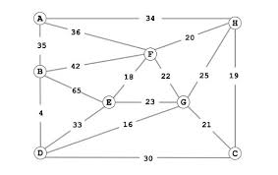
VERTICES IN SNOOKER
Balls: Each ball on the snooker table, including the red balls and the colored balls (yellow, green, brown, blue, pink, black), is represented as a vertex in the graph.
Cue Ball: The white cue ball is also a vertex.
Pockets: The pockets in the table are also the vertices.

Slide 9
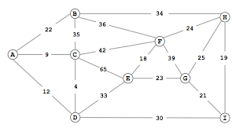
EDGES IN SNOOKER
Cue Ball Movements: Edges between the cue ball and other balls represent shots or movements made by the player. When a player hits a ball with the cue ball, there is an edge between the cue ball and the target ball.
Ball Pockets: Edges between balls and pockets represent successful shots or the movement of balls into pockets. When a ball is potted, there is an edge between the ball and the corresponding pocket.
Dynamic Graphs: The graph representation changes dynamically as players take shots, pot balls, and the positions of balls on the table evolve

Slide 10
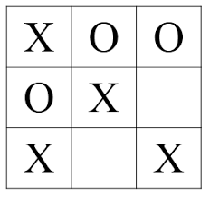
PART B
TIC TAC TOE
Certainly! Tic-Tac-Toe is a game that can be neatly illustrated and explored using graphs. Imagine each potential state of the Tic-Tac-Toe board as a point on a map, and the lines connecting these points representing the legal moves you can make in the game. The main objective is to grasp how the game unfolds, what potential results might emerge, and the smart strategies that can lead to victory.

Slide 11
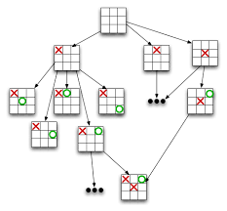
VERTICES AND EDGES
Vertices (Nodes): Each node in the graph represents a unique state of the Tic-Tac-Toe board. A state includes the placement of Xs and Os on the 3x3 grid. There are 9 possible positions on the board, and each position can be either empty, occupied by an X, or occupied by an O.
Edges: Directed edges represent valid moves from one game state to another. For example, if an empty cell allows placing an X or an O, there is a directed edge from the current state to the next state after making that move.

Slide 12
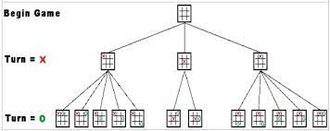
ANALYSIS
Game Trees: The graph structure can be visualized as a game tree, where each level represents a move in the game.
Strategy Analysis: Analyzing the graph helps identify optimal strategies, winning paths, and possible counter-moves

Slide 13
NUMBER THEORY
Q. Programming Tasks In Number Theory
a. Prime Factorization
b. Euclidean Algorithm For GCD
c. LCM Calculation
d. Bezout Coefficients
e. Modular Inverse
f. RSA Encryption
g. RSA Decryption

Slide 14
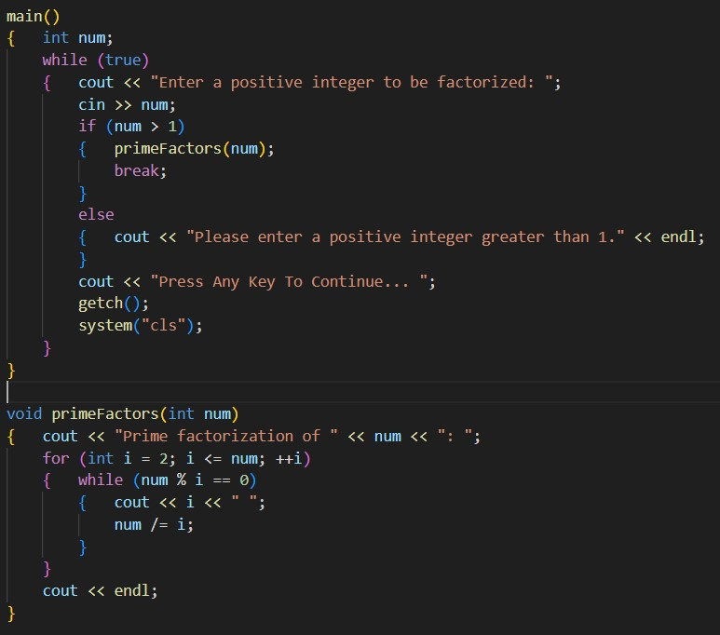
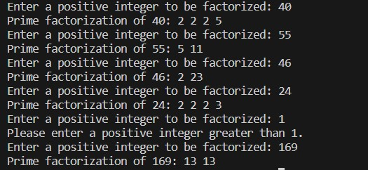
A. PRIME FACTORIZATION
OUTPUT:

Slide 15
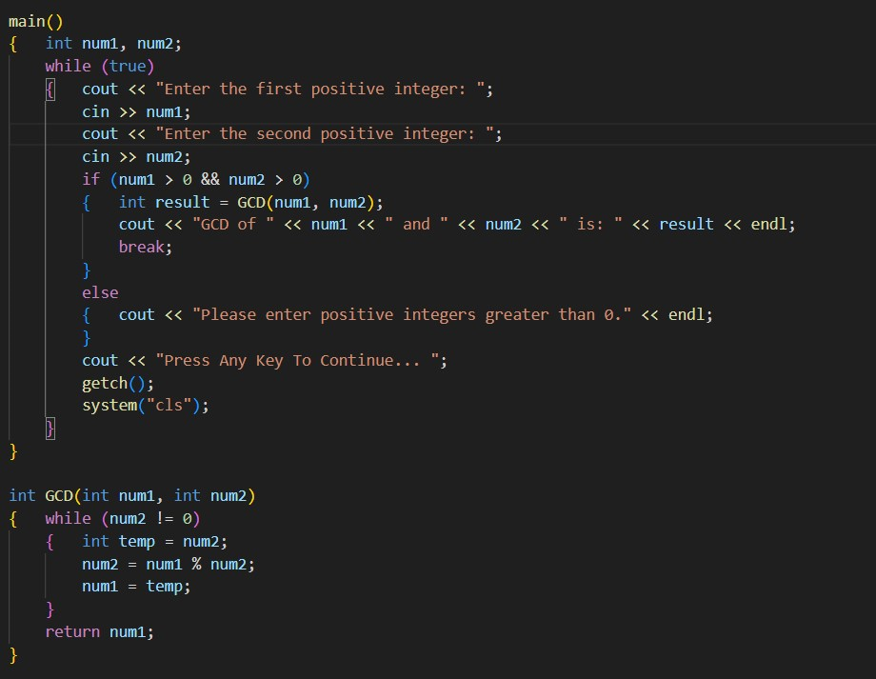
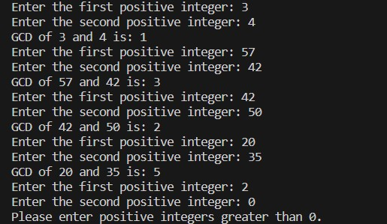
B. EUCLIDEAN ALGORITHM FOR GCD
OUTPUT:

Slide 16
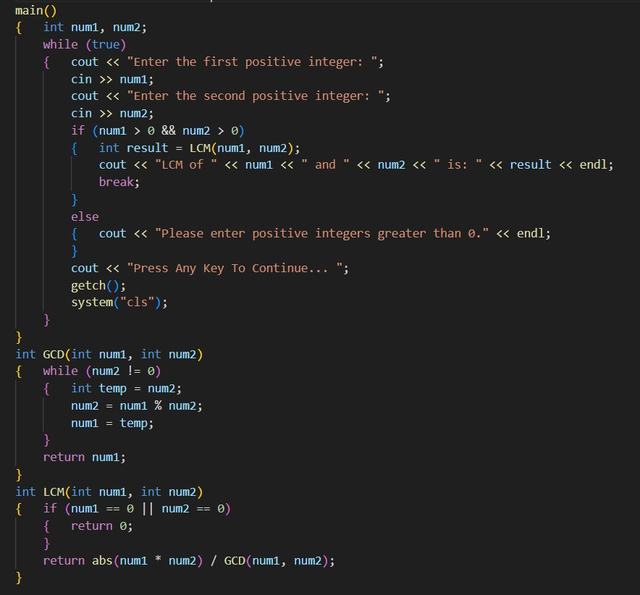
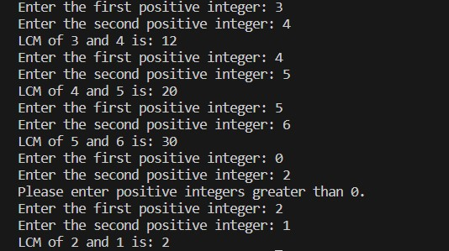
C. LCM CALCULATION
OUTPUT:

Slide 17
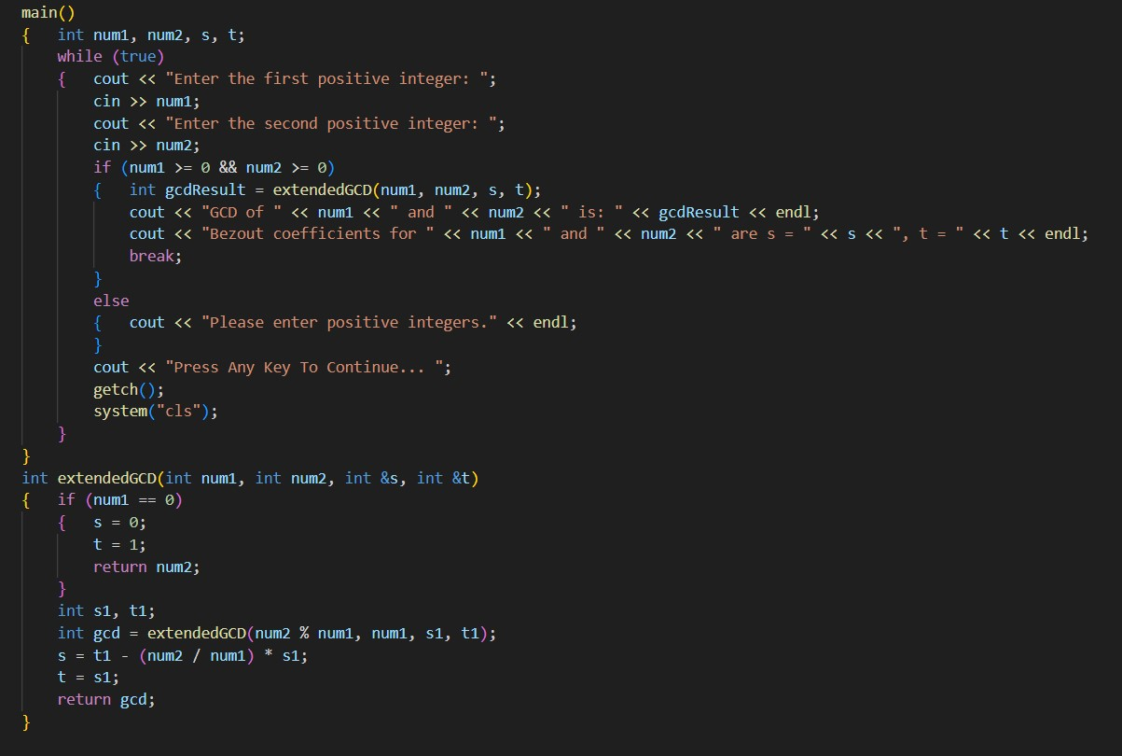
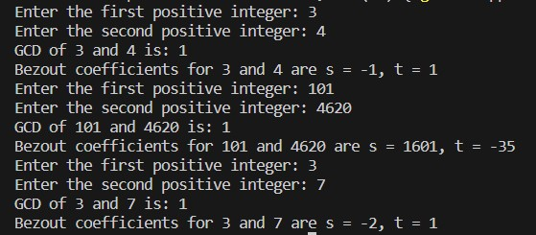
D. BEZOUT COEFFICIENTS
OUTPUT:

Slide 18
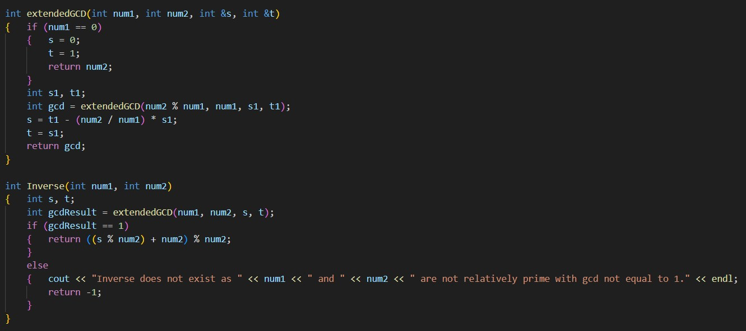
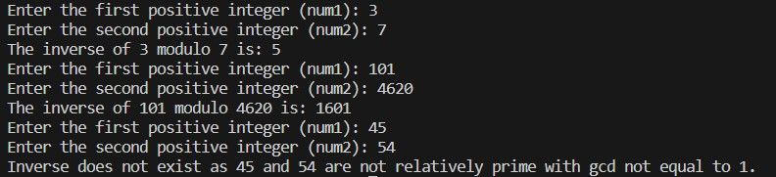
E. MODULAR INVERSE
OUTPUT:

Slide 19
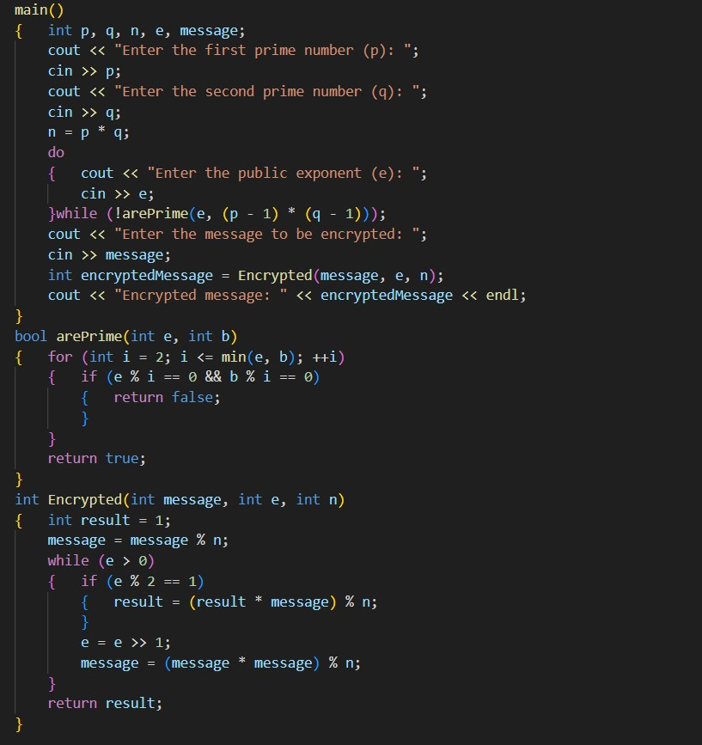
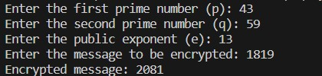
F. RSA ENCRYPTION
OUTPUT:

Slide 20
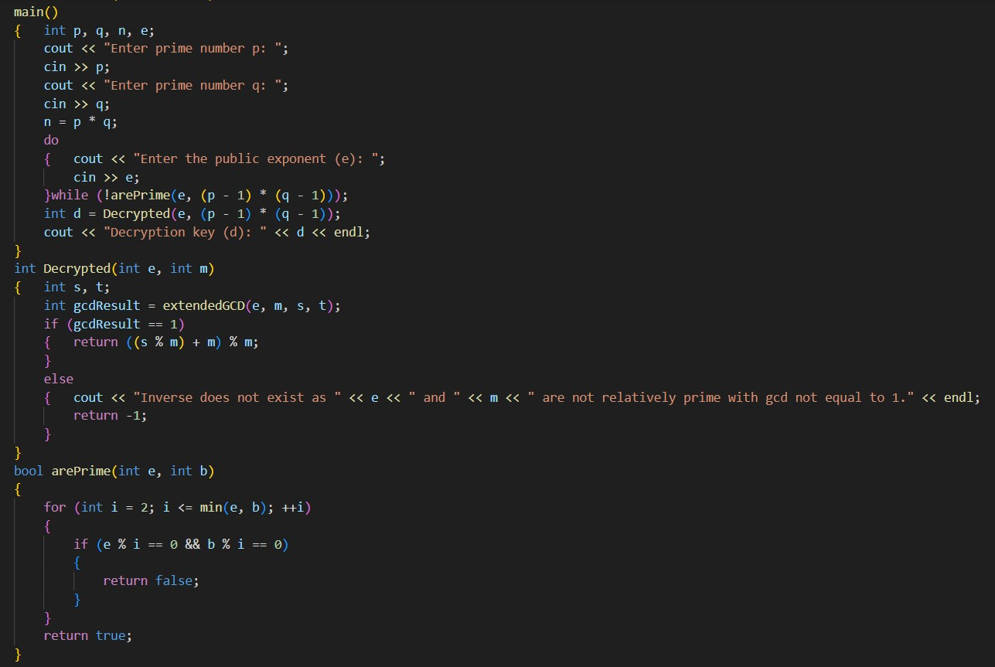

G. RSA DECRYPTION
OUTPUT:

Slide 21
CONCLUSION
That was all from my side. Make sure to check out my partner
Hannan Mushtaq’s LinkedIn for the rest of the project’s
video demonstration.

Slide 22
THE END! THANKS!

